Slide 1


Everyone Is Not Like You:
Dispositional Characteristics and the Team Environment Part 1
Dave Gosselin
Director
Environmental Studies
University of Nebraska-Lincoln
Notes:
Note: Everyone Is Not Like You: 1. Dispositional Differences Part 1 provides background regarding the importance of knowing about dispositional differences between and among team members and how theses differences can create challenges. Part 1 provides the framework for the practical application and consideration of dispositional differences in Part 2.

Slide 2
Pre - Session Reflection
(Five-Minute Writing)
Writing Prompts
From your perspective, to what extent should the dispositional characteristics (behaviors, values, and motivational drivers) of team members be considered when forming and/or working on a collaborative team?
From your perspective, what are the key factors/characteristics that are important in the development of a collaborative team environment? Why are each important?

Slide 3

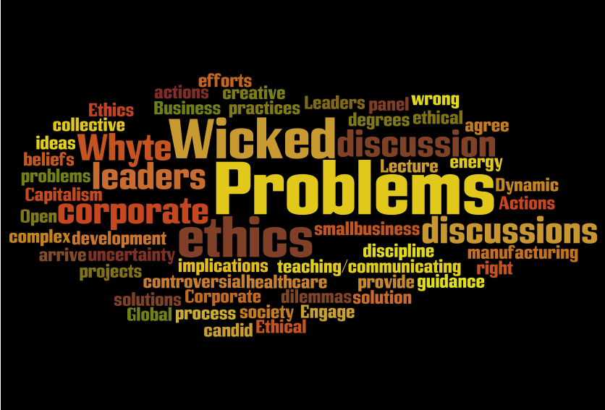
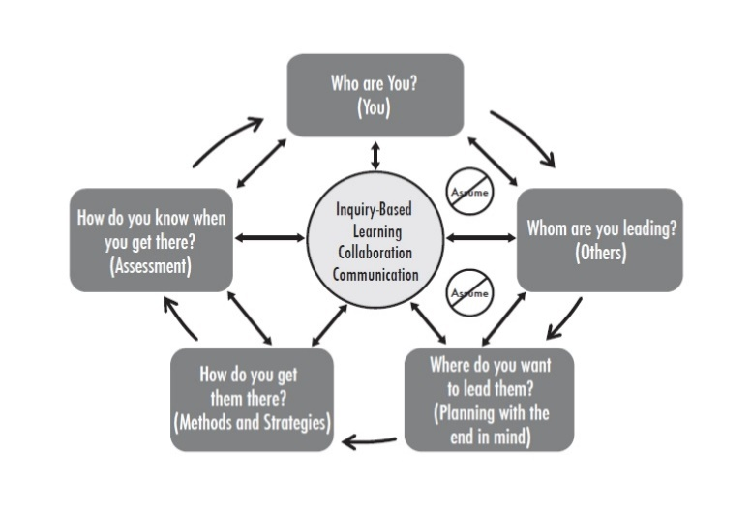
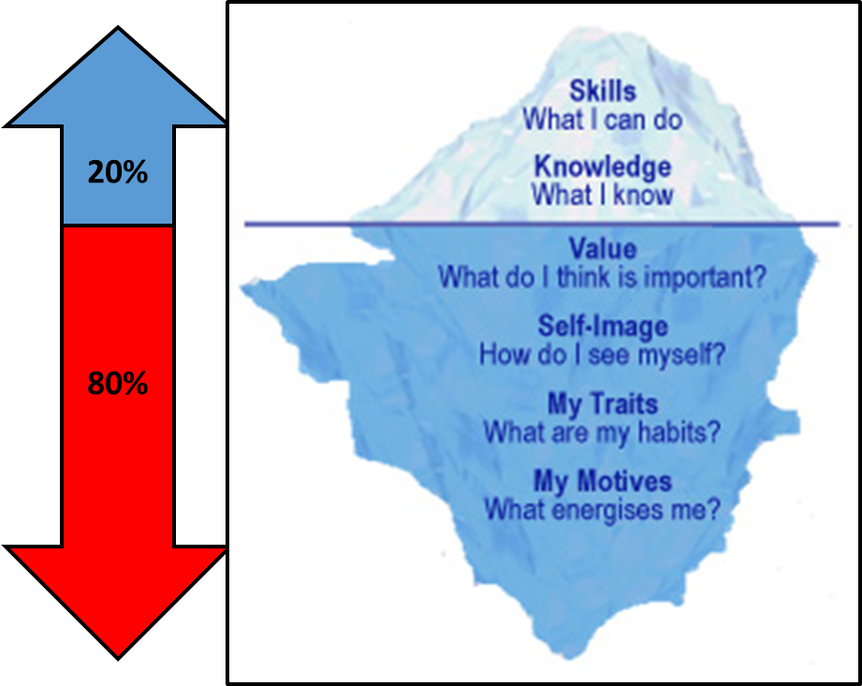
Take
Away
Messages
https://wmsbf.org/2013/02/21/1218/
Gosselin 2015
Notes:
The key take away messages from this EMBERS activity are:
Click 1. We need to develop silo busters who can build collaborative to teams to Click 2. address wicked problems.
3. Regardless of your leadership paradigm or philosophy or model for your experience on collaborative teams, it is important that you have a model for how collaboration and interdisciplinary work should be done and be sure that your model uses Click 4 knowledge of who you are and whom you are leading successfully address wicked problems.

Slide 4
Learning Outcomes
Upon completion of this activity, the participant will be able to:
Identify the key characteristics of collaboration
Describe the concept of dispositional distance
Explain the importance of navigating and negotiating dispositional distance between team members to successful team outcomes
Evaluate the role that dispositional characteristics may have played in previous team/collaborative experiences

Slide 5
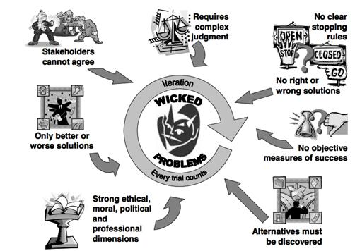
What are wicked problems
http://comphacker.org/comp/engl338/2015/01/28/visuals-of-wicked-problems/
Notes:
One of the overarching themes of the EMBeRs project is to provide a structured, participatory engagement process that will help address wicked problems that are inherently ill-structured. Before going forward, it is always good to define term so what are wicked problems. Wicked problems are those that require complex solutions that have a range of dimensions including ethical and political among others. The solutions are not right or wrong, there may be only better or worse, and without question, stakeholders including members of interdisciplinary research teams will not be able to come to agreement on the solution.

Slide 6
Examples of Wicked Problems
Food-Water-Energy
Healthcare
Natural Hazards
Urban Water Systems
Pandemics
Education
Sustainability
Global Climate
Change
Notes:
Engage your students, Toss out the question: What are examples of Wicked Problems?
Use these examples or add your own.

Slide 7
Skills Employers Want
Future Intellectual and
Workforce Demands
Notes:
One of the biggest challenges for education is to prepare today’s students to meet the future intellectual and workforce demands that are required to address the many “wicked problems” facing society. Wicked problems are real life challenges involving complex systems that are characterized by legitimate, competing values, difficult to predict cause and effect relationships, high degrees of uncertainty, and multilevel social interactions (Rittel and Webber 1973). To address these wicked problems requires effective interdisciplinary and transdisciplinary teams composed of physical and biological scientists, social scientists, economists, policy experts, among many other disciplines. To develop effective interdisciplinary and transdisciplinary teams, we need silo busters.
Becoming a silo buster requires the skills of communication and collaboration whose importance goes far beyond the academic application and extends into the important realm of creating effective employees as reflected in the Skills Employers Want website. http://www.strath.ac.uk/careers/skills/

Slide 8
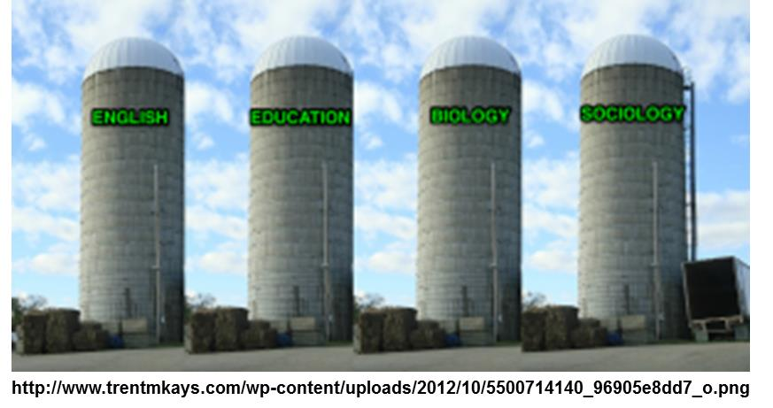
Solving
Wicked Problems
Require
Silo Busters
The silo effect:
Is an isolation and lack for connectedness of systems components.
Leads to the inability of anyone within one silo to see the others.
Results in thwarted communication, potential redundancy, wasted energy, wasted resources, internal competition, limitations on collaboration, and, frustration.
Notes:
Solving wicked problems requires silo busters. The silo effect thwarts communication that, in turn, limits the extent to which collaboration can occur amongst the members of a team. For those not familiar with the term silo effect, it is a phenomenon occurring when systems components fail to communicate with each other. The row of silos pictured at the top left is a symbol not only of the lack of connectedness of these units, but of the inability of anyone within one silo even seeing the other silos. In the corporate world, that could be accounting isn't talking to manufacturing who isn't talking to marketing. In the education world, that could mean curriculum isn't talking to assessment, or maybe K-5 isn't talking to the middle school. Whatever the locus, developing skills and approaches to effectively communicate and collaborate are critical to becoming a silo buster.

Slide 9
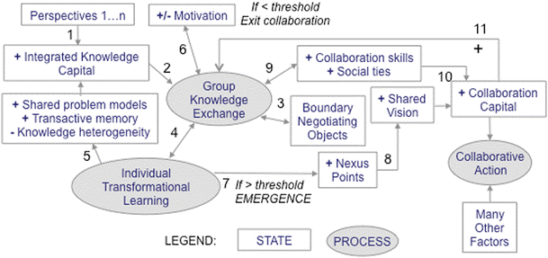
Framework: Conceptual Interaction Model
Pennington 2016
Model of Model-Based Reasoning
Notes:
Whether we realize it or not, we all have some type of framework or model for how a collaborative, interdisciplinary team functions. Our EMBeRS colleague, Deana Pennington in 2016 (See descriptions of the details of this diagram in the paper), presented a framework, which she refers to as a conceptual interaction model, that is at the foundation of the EMBeRS process. A key attribute to this model is that it recognizes that for any team process multiple perspectives (click) are brought into a project and that to effectively bring these perspectives together a process of knowledge integration that links individual, group, and system factors should be used. In this workshop, we advocate for the use of a model based on model-based reasoning.

Slide 10
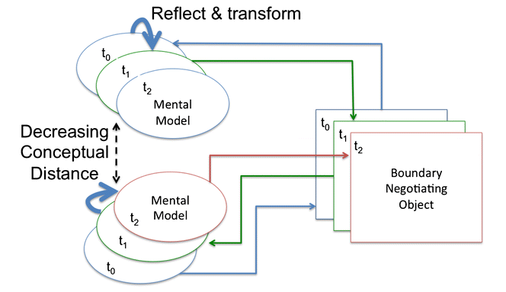
Model of Model-based Reasoning (t₀ to t₂)
Pennington et. al 2016
Conceptual Distances and
Shared-Mental Models are Negotiated
Pennington et al. 2016
Notes:
As explicitly described in Pennington et al. (2016), the model of model-based reasoning results in the negotiation of shared-mental models over time (t0 through t2) using boundary negotiating objects. Ovals represent internal individual mental models; rectangles represent visual externalizations. Arrows represent information flow through time. At t0, an individual constructs a boundary negotiating object that represents their mental model. Another
individual reflects on that model, transforms their own mental model in response, and proposes a modification to the boundary negotiating object
that better represents their perspective. This continues until a contingent final model is agreed upon. The process results in decreasing conceptual
distance among participants, i.e., better-developed shared mental models of the problem.

Slide 11
Conceptual Interaction Model
Pennington 2016
Collaboration Development
Notes:
Another critical component of the conceptual interaction model is the importance of the development of collaboration in the process of creating a shared vision and resulting collaborative action. The remainder of this activity will be focusing on components of the collaboration process that will hopefully enhance collaboration capital and collaborative action.

Slide 12
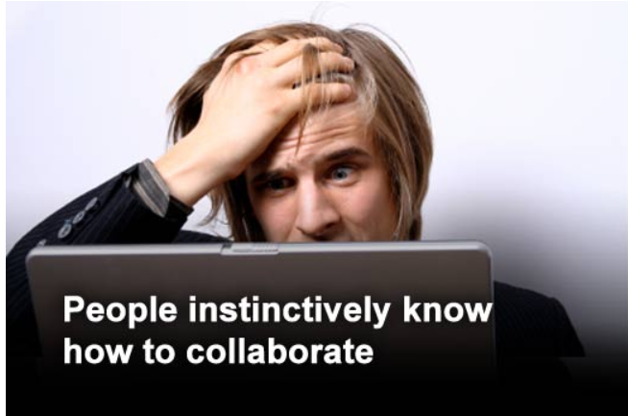

‘Get people together and it’ll happen naturally.’
A
Mythical
Story
http://www.itbusinessedge.com/slideshows/show.aspx?c=90557&slide=6
From Five Collaboration Myths
Notes:
There a variety of myths that exist regarding collaboration, the number one myth from my perspective is that if you get people together collaboration will happen naturally. Most people if asked what collaboration is will struggle to define it. Collaboration is not instinctive. It is important to know about the key characteristics of collaboration and develop a process that promotes the development of these characteristics.

Slide 13

Write a short story
about a Good, Bad or Ugly Team/Group Experience
Share the story with your group
Notes:
Let us begin our investigation of collaboration by considering previous experience. In your notes or on your computer, write a short story about a Good, Bad or Ugly Team/Group Experience
Tell us why it was Good, Bad or Ugly
Share the Story
(Note: This may take 5 to 15 minutes)

Slide 14
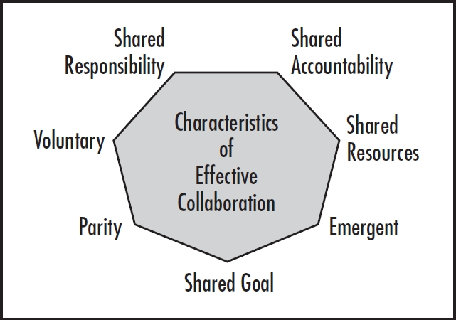
Reflect: Characteristics of Collaboration
(Shared Vision)
In Gosselin, 2015; Characteristics Adapted from Friend and Cook, 1996
Notes:
One thing we do not do as often as we should is reflect on our experiences to better learn from. One of the most important attributes of the EMBeRS model is that developing an effective collaborative environment is important to development of interdisciplinary teams. The iterative nature of the EMBeRS approach embeds on one the key characteristic of effective collaboration that is, collaboration is emergent in that it takes time and effort to develop a share goal/ shared vision. Take a few minutes and consider the characteristics of effective collaboration.
Note to Instructor: Provide a brief overview of each chararcteristic (see below) or See Resource: Collaboration Characteristics Summary Excerpt from Gosselin 2015 for the text below.
a. Collaboration is voluntary.
There are two levels regarding the voluntary aspects of collaboration—participation and whether the participants want to use collaborative practices. Participation in this project was voluntary. The extent to which the participants wanted to use collaborative practices could explain the effectiveness of various teams. However, it should be noted we never discussed collaborative practices, so most groups functioned using their perceptions about how a team should function.
If true collaborations are to develop within teams, intrinsic motivation must be used for team members to see value in the partnership and feel that they have a clear choice to participate. Faculty can be recruited but not coerced. Pre-service teachers can be required to have inquiry experiences, but the details and commitment must be left to them; and classroom teachers must freely choose to be involved. You cannot force people to collaborate. You can throw them in a room together and tell them to be a team. Ultimately they will choose how they will work. If they have never been provided a foundation in collaborative practices, then the extent to which these practices will be used is minimized. In our case, it was the luck of the draw when we put the groups together.
b. Collaboration is based on parity.
Each member of a collaborative team must see that their contributions are equally valued, even if those contributions are drastically different. In this project, highly effective teams had members who developed and contributed unique skills for the good of the entire project. All members valued the contributions made by each member.
All team members’ perspectives must be heard. Different points of view lead to better and more comprehensive outcomes. For example, the scientist was certainly the content expert, but the classroom teacher knew how the research findings ultimately had to be packaged to create curriculum, and the pre-service teacher many times became the skilled technician who held the key to good test results. The concept of being valued is critical to the success of any athletic team. Members of the most successful teams will all have a sense that their contributions to the team are important.
c. Collaboration requires a shared goal.
This characteristic emphasizes the importance of a participatory process in developing your end-in-mind. The most effective teams shared a common vision or common goals of the task and the desired outcomes. Sharing a common goal provides a strong sense of team purpose that serves as a beacon for team success. One of the biggest challenges that we created for ourselves with this project was, at the time, that we did not know how important having this shared goal would be. The driving force for establishing team makeup was the research to be accomplished. The only connection requested was that team members be willing to work together on a question established by the scientist.
From the start, this created many challenges for the teams to establish a shared goal as well as parity. We were asking these people to work together on projects based on interest in the topic. We assumed that a working relationship would form around that tie to a common interest, and by inference the team would have a shared goal. We created working teams, with a focus on the “what” these teams would do, but we invested no time or energy in “how” individuals were to work together. This was a valuable, but tough lesson to learn.
d. Collaboration is emergent.
The most successful teams spent far more time together than other project groups and, as a result, communicated with each other far more often. This time on task and open communication facilitated, and was critical to, success. The best collaborations grow as the relationships among team members grow.
As we examined the effectiveness of the teams, as defined by both products created and comments from interviews about their working relationships, we found that those more productive teams had formed working relationships that became a driving force to their work. For example, the most effective team in the project under discussion still met almost daily during the project, and the scientist and K-12 teachers continue to meet fourteen years after the project ended. They saw the results of their investment in time multiply, as each member's expertise developed. This attribute clearly suggests that short-term projects, designed for a few hours or even a couple of weeks, may fail to provide the time needed to develop effective collaboration. Newly formed teams need to spend time talking about their purpose, how they plan to work together, and what they hope to accomplish.
They also need to develop a sense of trust among team members if they are going to achieve maximum effectiveness. If they fail to develop trust, they are likely to experience difficulties later in the process. Time with your team is critical to relationship development, which is critical to developing trust; hence, it is critical to development of an effective collaborative team.
e. Collaboration includes shared responsibility for key decisions.
The most effective teams jointly discussed key decisions of research design and interpretation, and every member made contributions. On the other end of the spectrum, in the least effective teams, generally one member of the team, typically the scientist, told team members what to do and when. This approach sabotaged the entire collaborative process. As a result, not only did the team members not have a shared goal, they did not have an opportunity to get truly invested in the project, because they had nothing invested in defining the outcomes—because they had nothing invested in the decisions. The educators were not treated as equals and acted accordingly. Promoting shared responsibility for key decisions can be accomplished through consensus-based decision-making. It is critical that the team members need to take responsibility to define what they mean by consensus-based decision-making and how it will be used.
f. Collaboration includes shared accountability for outcomes.
Because members of effective teams favored direct input into key decisions, they stood ready to take full responsibility for accomplishing the needed tasks. In addition, because they established open communication, members knew their roles and felt a sense of responsibility to each other.
Promoting a sense of individual accountability among all team members is an important attribute for creating a shared sense of accountability, as well as shared responsibility. Individual accountability is observed when each member of the team takes responsibility for speaking up, contributing to group discussions and decision-making, praising the contributions of others, following through on identified tasks, and reflecting on the overall functioning of the team.
g. Collaboration is based on shared resources.
Just as each member must have a sense of parity, members must feel that their contribution plays a crucial role in task accomplishment. Team members can contribute time, space, equipment, expertise, or other assets. In whatever shape or form they are contributed, the contribution of the resources should be acknowledged.

Slide 15
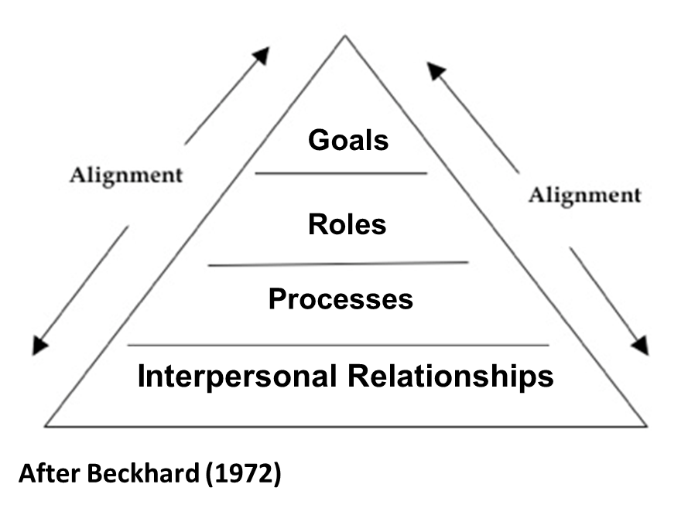
Reflect: Team Effectiveness Models
Goals: Outcome and Process; results; Metrics – measures; Specific, time-bound, accountable
Roles: Leadership; Individual responsibilities, accountability, authority; share responsibility
Processes: How do we ‘operate’; How we get them to the goals; Norms; Decision-making; conflict resolution; Team and work processes
Interpersonal Relationships:
How you work together?
Expectations of one another; Relating to one another
How you mutually support one another; collaboration; conflict management
Trust
Notes:
There are other contexts that can be used for reflection. For example, you can consider your experience in the context of team effectiveness models. This diagram illustrates the key components of the Goals, Roles, Processes, and Interpersonal Relationship – team effectiveness model initially developed by Beckhard in 1972. Note that a key attribute, or outcome to having quality interpersonal relationships is the development of trust.
Note to Instructor: Provide a brief overview of each part of the model (see below).
The GRPI model is simple framework for any project to facilitate team’s success.
Goals: well-defined objectives and desired results, plus clearly communicated priorities and expectations. Other attributes include:
Clarity about the main purpose of the team
• Agreement on the desired results
• Understanding of the main tasks
• Agreement on the standards and expectations
• Clarity of priorities and deadlines
• Understanding of boundaries
Roles: well-defined responsibilities, acceptance of a leader. Other attributes include
• Acceptance of a team leader
• Understand all members’ roles
• Individual responsibilities
• Shared responsibilities
• Clear boundaries
• Identify and fill gaps
Processes: clear decision-making processes as well as work procedures. Other attributes include
• Team processes – (e.g., how decisions are made, how the team
solves problems and resolves conflict, communication)
• Work processes – (e.g., procedures and work flow)
Interpersonal relationships: good communication, trust, and flexibility.
• Relating with the other team members
• Trust
• Sensitivity and flexibility with each other
• Good communication
• Collaboration in problem solving
• Effective methods for dealing with conflict team and planning the first steps or revisit if a team starts to flounder.

Slide 16
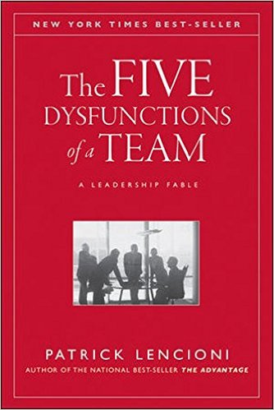
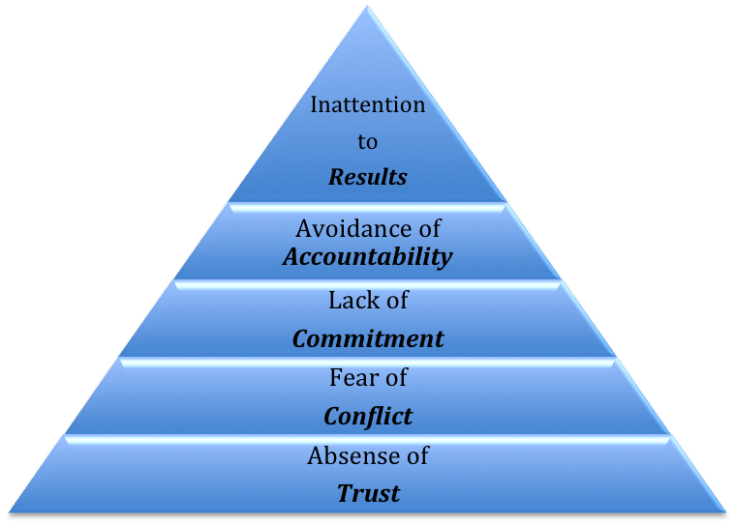
Reflect: Team Effectiveness Models
Five Dysfunctions of a Team
Notes:
In Patrick Lencioni’s team effectiveness model, Five Dysfunctions of a Team, he developed a work team effectiveness model based on what causes dysfunctions, conflicts, and political maneuverings in a team. The foundation for dysfunction is an absence of trust among team members creating an environment where the comfort level among individuals is such that they are afraid to be vulnerable, afraid to ask for help or assistance. Because of the lack of trust and the needed interactions for work, this leads to the fear of conflict that limits the development of productive ideas. This in turn leads to the other five dysfunctions.
Click on the Five Dysfunction of a Team link for brief summary by Patrick Lencioni.

Slide 17

Reflect: Revisit your story
about a Good, Bad or Ugly Team/Group Experience
Assess your experience in the context of the characteristics of collaboration and how the models of team effectiveness relate to the extent to which your experience was good, bad, or ugly.
Share assessment with your group – similarities and differences
Notes:
Revisit your story - assess your experience in the context of the characteristics of collaboration and how the models of team effectiveness relate to the extent to which your experience was good, bad, or ugly.
Share your assessments with your group, compile common themes…similarities and differences.
Note common themes for the class…..

Slide 18
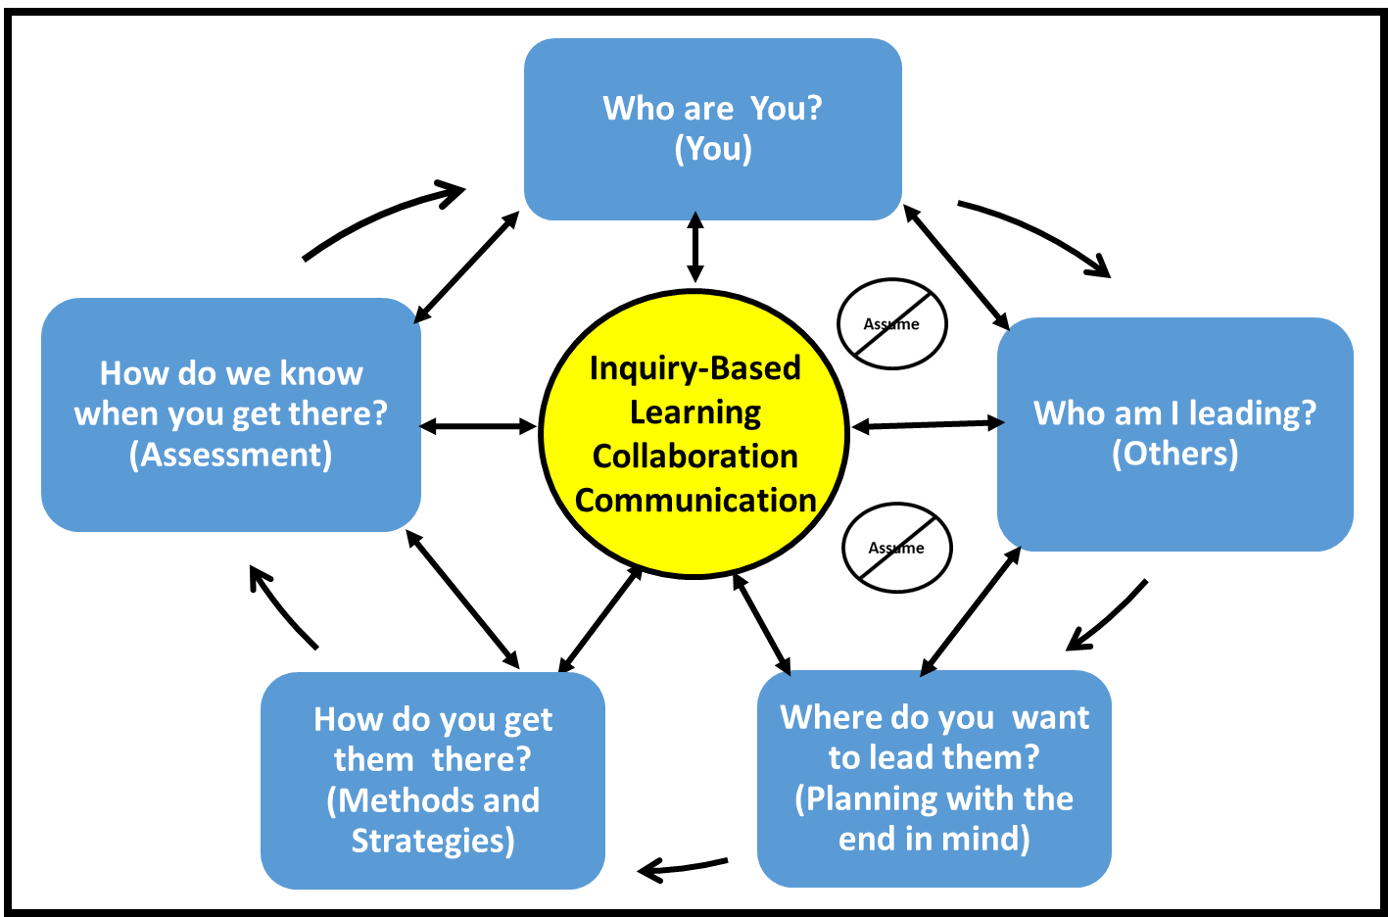
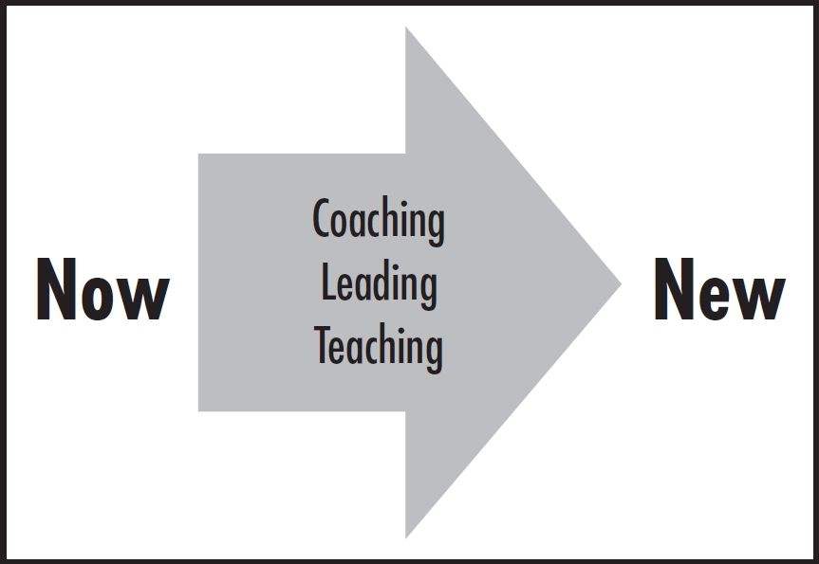
Framework: Collaborative Leadership Action Model (Gosselin 2015)
Notes:
A fundamental component to any collaboration or team are people. Gosselin (2015) in his book Focus on Them: Leading the Mindset Revolution for Coaches, Educators, and Business Leaders developed what is now referred to as a collaborative leadership action model. A fundamental premise behind this model is that leading, coaching, and educating are all about taking individuals and organizations (i.e., people) from where they are now to someplace new. Fundamental to going from “now to new”, requires the creation of an environment where learning, collaboration, and communication are central themes. To create this type of environment, action needs to be taken on five framework questions highlighted in the blue boxes. Of these five question, the “knowing who you are” (Click) and ”knowing who you are leading” (Click) are often overlooked or underemphasized as critical components to moving individuals, team or organizations forward.

Slide 19


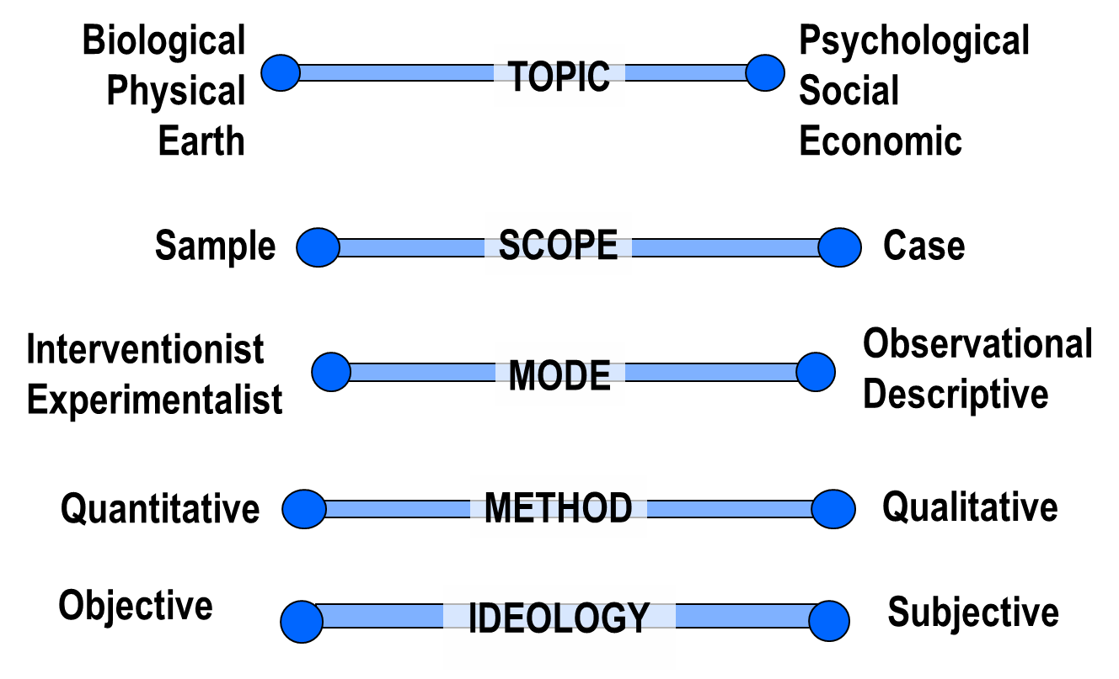
Difference in
Knowledge and Skill
“You and me, we come from different worlds”
Hootie and the Blowfish
● Ways of knowing and researching are different
(See Everyone Is Not Like You:
2. Epistemology Differences)
Notes:
One area that needs to be explored in the context of “knowing who you are” and ”knowing who you are leading” when a group of people are interacting are differences in knowledge and skills. It is important with any group of people to embrace the wisdom of Hootie and the Blowfish who pointed out that “You and me, we come from different worlds” These different worlds manifest themselves in the disciplinary topics we study, the mode and scope of our investigations, and the methodology and ideology we use to research and investigate. These differences in ways of knowing are referred to as differences in epistemology. Epistemology is study of the nature, and origins of knowledge, limits of human understanding, and how knowledge is derived, tested and validated.
Read more: http://www.businessdictionary.com/definition/epistemology.html#ixzz33EWVw9rn
These difference are addressed in Everyone Is Not Like You: 2. Epistemology Differences.

Slide 20
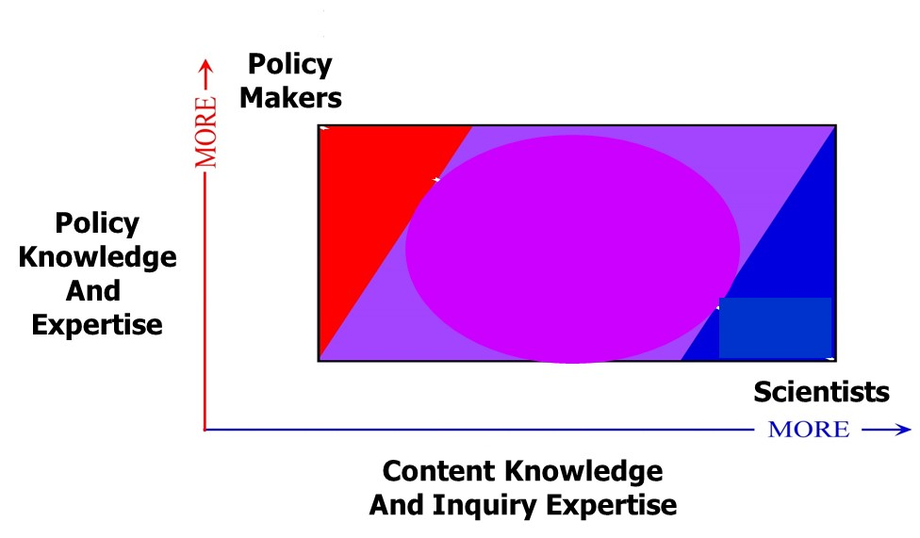
Different Expertise
“You and me, we come from different worlds” Hootie and the Blowfish
Differences in Knowledge, Skill, Expertise, and
Mental Models = Conceptual Distance
Notes:
As a result of our academic, research, work, and life experience, we all have different levels of knowledge, skill, and expertise along with difference in our mental models. The differences in these attributes are referred to as conceptual distance in our EMBeRs approach.

Slide 21
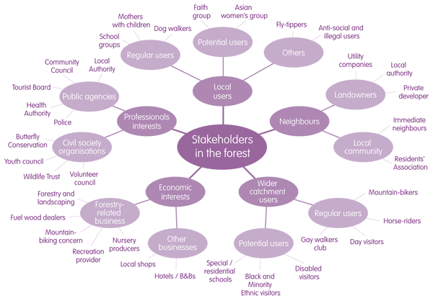

Multiple Perspectives
“You and me, we come from different worlds” Hootie and the Blowfish
Notes:
In addition to the range of knowledge, skill, and expertise along with differences in mental models in your group or team, there are also a range of perspectives from stakeholders external to your team that need to be considered regarding wicked problems. These stakeholders also have different knowledge, skill, and expertise along with differences in mental models. Again, there is nothing wrong with the differences. They just need to be recognized, appreciated, and articulated.

Slide 22
Reflect: Revisit your story
about a Good, Bad or Ugly Team/Group Experience
Assess your experience in the context to which differences in knowledge, skill, expertise and mental models influenced the extent to which your experience was good, bad, or ugly.
Share assessment with your group – similarities and differences
Notes:
Revisit your story - Assess your experience in the context to which differences in knowledge, skill, expertise and mental models influenced the extent to which your experience was good, bad, or ugly.
Share your experiences with your group, compile experiences…similarities and differences.
Note common experiences for the class…..

Slide 23
Model of Model-based Reasoning (t₀ to t₂)
Pennington et. al 2016
Conceptual Distances and
Shared-Mental Models are Negotiated
Notes:
The process of model-based reasoning provides an approach to recognize, appreciate and articulate differences in conceptual distance and mental models through a process of negotiation.

Slide 24
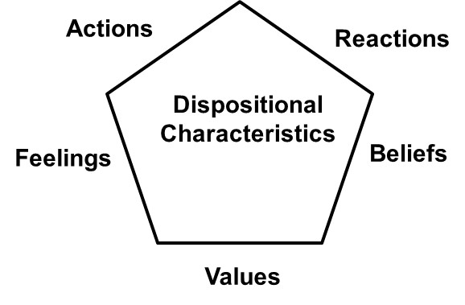
Dispositional Characteristics Contribute Challenges to Closing Conceptual Distance
“You and me, we come from different worlds”
Hootie and the Blowfish
Behaviors
Motivational
Drivers
Everyone experiences the world differently
Notes:
Differences in knowledge, skill, expertise, perspectives, and mental models among member of interdisciplinary and transdisciplinary teams contribute to the on-going struggle to achieving knowledge integration across disciplines. Another important part of the struggle with integration is recognizing that there are dispositional characteristics that contribute significant challenges to the process of closing conceptual distance. These characteristics result in everyone experiencing that world differently. A person’s disposition, most simply, is their attitude of mind. Attitude is a complex mental state involving beliefs, feelings and values (click: motivational drivers) that strongly influence a person's characteristic actions and reactions (click: behaviors) to act in certain ways . The term dispositional characteristics is used to refer to the behavioral and motivational drivers for an individual.

Slide 25
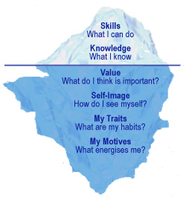
Iceberg Model for
Personal Characteristics
Traditional Academics
Question:
To what extent have you considered the 90% below the line and its impact on you and team
dynamics?
10%
Behaviors
90%
Motivational
Drivers
Notes:
The iceberg model is used in many contexts and can be traced back to Sigmund Freud’s ‘Iceberg Model of Consciousness’. In the context in which it is applied here the 10 percent of the iceberg (Click) above the water are the personal characteristics that are most “visible” to others. These include what you can do, your skills, what you know, your knowledge, along with various components of how you act and react to people and situations, your behavior (Click). These visible characteristics are typically the focus of traditional academic programs. The 90% of the iceberg below the line consists of what we refer to here as our motivational drivers (Click). An interesting question (Click) is, “To what extent have you considered the 90% below the line and its impact on you and team dynamics? These drivers are the why behind the choices we make to invest time and energy doing what we do. Our motivational drivers orient our behavior and can be deep seated in the recesses of our minds. These ‘deeper’ characteristics will influence how well we are matched with our roles or jobs. Although the motivational drives are the reasons behind our behaviors, we do have a choice about behavior. If you understand your motivational drivers and those of others you can better manage your individual behaviors as well as your behavioral interactions with others. The ability to understand yourself at a level where you know what you want to do and why you want to do it is one of the most challenging tasks that you will face. Yet knowing self and what is below the line is critical to becoming the most effective collaborator, teammate and leader you can be.

Slide 26
Dispositional Differences =
Dispositional Distance©
Reactions
Person 2
Behavioral
Characteristics
Dispositional
Distance
Person 3
Person 1
Actions
Feelings
Beliefs
Values
Motivational Drivers
Navigate and Negotiate Dispositional Distance©
Notes:
Every person on your team will have different behavioral characteristics and motivational drivers as schematically shown here. We use the concept of dispositional distance© (click) to describe the differences in the dispositional characteristics of team members. There are inherent dispositional distances between all people on teams. If dispositional distances are short, team members may work more effectively together. As the distance grows longer, team members may have more challenges effectively working together. In either case, each person on a team needs to learn about these differences and how to navigate and negotiate the dispositional distances between group members so the team can get the most out of its talents and abilities.

Slide 27
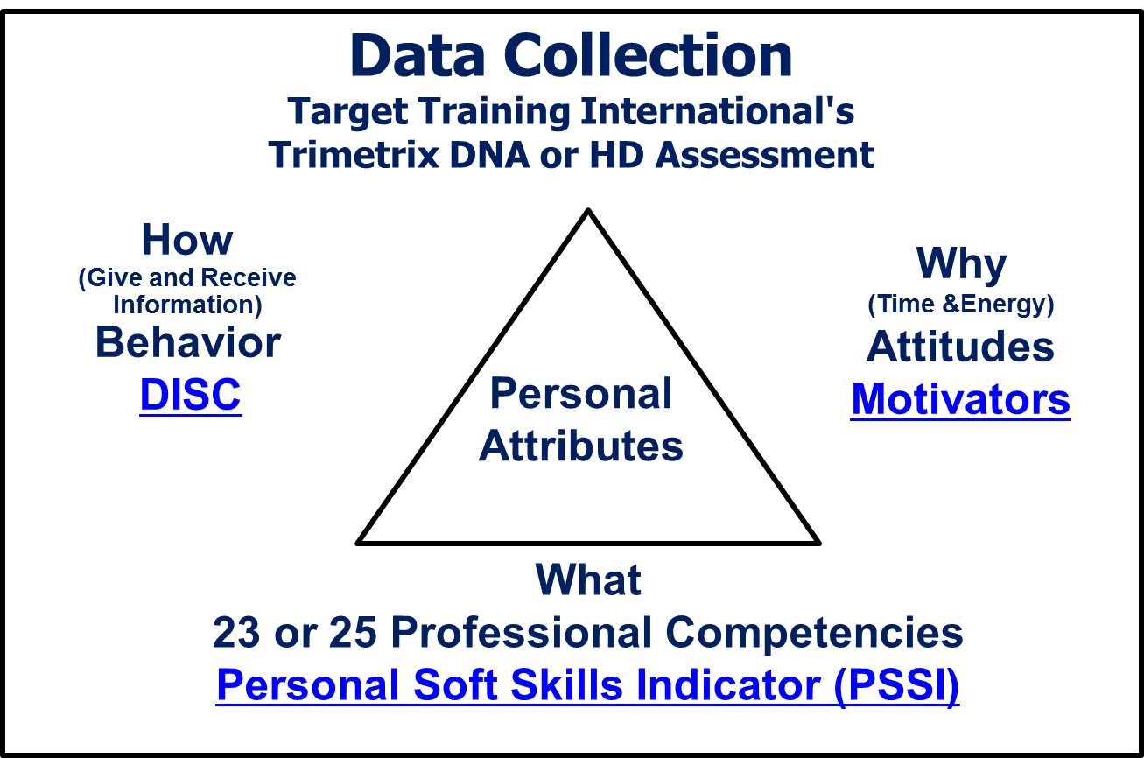


Accessing Dispositional Characteristics
Use Assessments
Know yourself and your teammates (Boundary Objects)
Notes:
The key to ascertaining a person’s true potential lies in accessing these deeper recesses of his mind. A variety of psychometric tools and exercises (click) can provide insight into these characteristics. Many of these tools use standard and scientifically based methodology to measure individual’s behavioral style, motivational drivers, personalities. (click) Assessments are not intended to separate the good and bad. There is NO good or bad. Just different. (Click) Is the report 100% true? Yes, no and maybe. None of the assessments are 100% accurate. Their value lies in their ability to get you to focus on your own behavioral and motivational characteristics – your manner of doing things and why you might do them – and providing you with a boundary object* that you can use to explore the similarities and differences among your group members and how these characteristics may influence your abilities to work together and adapt for success.
*Boundary Object = documents and vocabulary that can help people from different communities build a shared understanding through a common language. In this case the reports provide information in a common language for all participants.

Slide 28
Assessment of
Dispositional Characteristics
An Example
Notes:
An example of one of the many psychometric tools and exercises (click) that can provide insight into dispositional characteristics is TTI Success Insight’s TriMetrix® Assessment. This assessment instrument provides information about the behaviors, motivators, and professional competencies for individuals. Regardless of the instrument one uses, it has been well documented that effective leaders know their strengths and weaknesses and don't assume that they know everything. Knowing yourself requires reflection and thinking about these types of things. At the team level, effective teams work to understand and reflect on the characteristics of others on the team. This facilitates better communication and interaction among team members. Assessments can help the reflection process at both the individual and group levels.

Slide 29
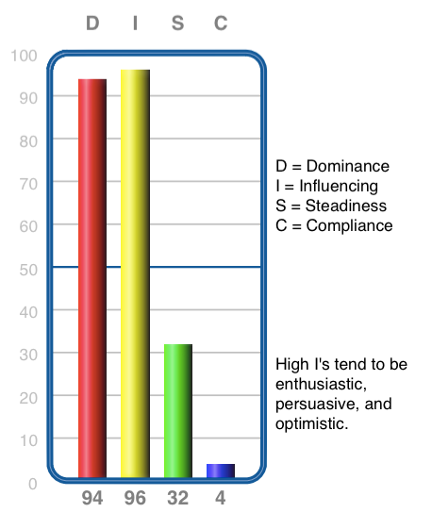
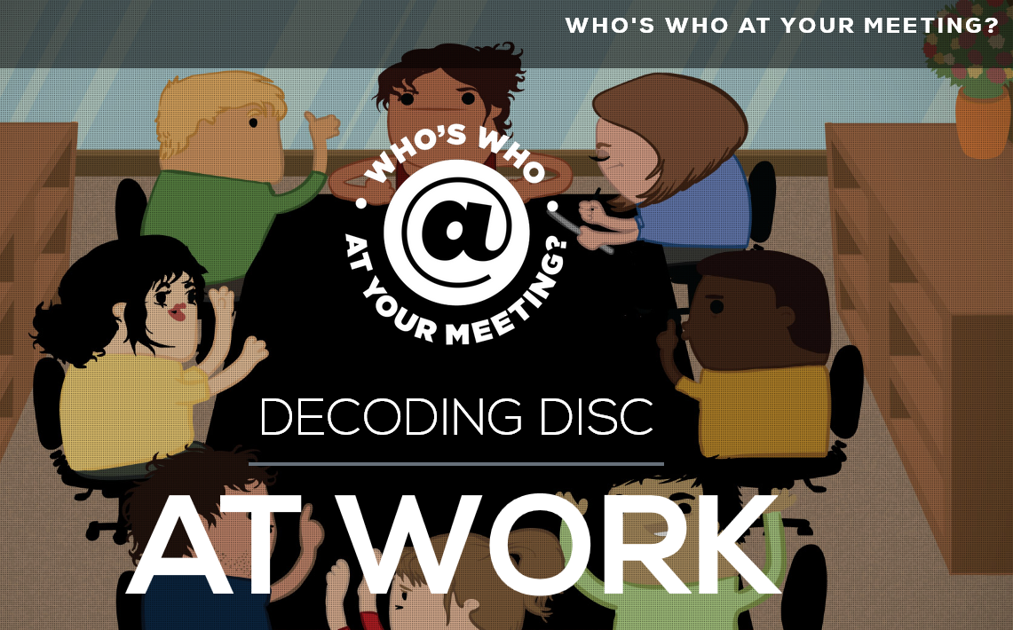
How we act: Our Behavioral Characteristics
https://www.ttidisc.com/
We have All Four
– Varying Intensities
Notes:
As part of Talent Training International Success Insight’s TriMetrix® Assessment, the DISC Model is used to describe a person’s behavioral style on a continuum of four primary behavioral dimensions that results in 384 distinct patterns. These dimensions are:
• D dimension - how an individual manages problems/challenges.
• I dimension - how a person uses their influence with people.
• S dimension - in the simplest terms, their steadiness, which reflects how the person deals with pace and change.
• C dimension - how an individual deals with procedures and complying with rules and other constraints that may be placed on them by an organization.
A very important concept here is that an individual’s behavior is a blend of all four dimensions that results in everyone having their own DISC profile. Clicking on https://www.ttidisc.com/ will provide more specific information about the four dimensions.

Slide 30
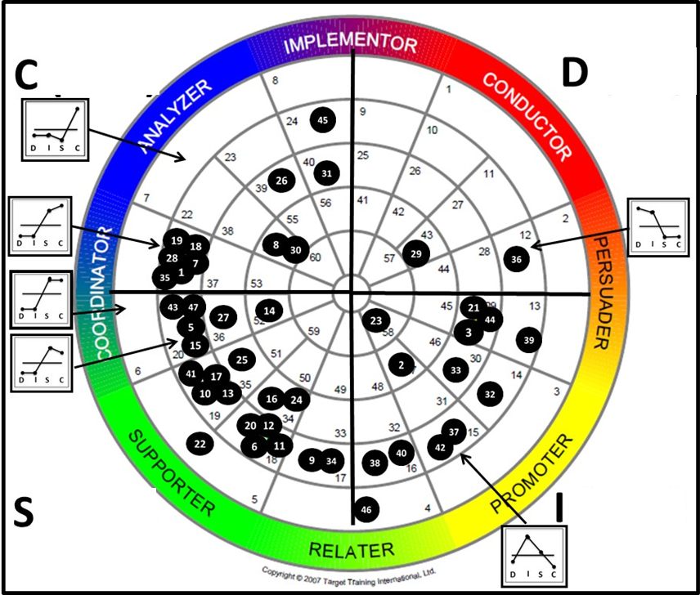
Team Building Support Materials
Team Wheel - Behaviors
Compliance
&
Procedures
Problems
&
Challenges
We have
all four
Pace and
Consistency
Influence
People
TTI Success Insights Wheel®
Notes:
Moving up to a team level, the behavior data for a team can be presented on the TTI Success Insights Wheel®. The wheel is divided into four quadrants based on the influence that the four primary behavioral dimensions, D, I, S, C, have on a person’s overall behavioral characteristics. An analogy that can be used to help interpret the wheel is to imagine a magnet at D, I, S, C. The stronger the dimension influences the behavior, the stronger the force the magnet has to pull away from the center of the circle. The differential pull from the four corners results in different patterns of DISC relative to the energy line, which is the horizontal centerline, in all the small embedded graphics. Each numbered field on the wheel represents a different pattern in D, I, S, and C. The pattern in field 7 is associated with a person whose C dominates – has a C score high above the energy line and a D, I, S below the line. The inset graphs show examples of other DISC patterns for other patterns around the wheel.
For more details, regarding the interpretation of the wheels see Bonnstetter and Suiter (2013).
The team wheel illustrates the diversity in teams and how differences can be strengths, when one understands what each member brings to the table. As we have grown as a team, we have come to focus on our strengths. A crucial takeaway message is that effective leaders need to see the potential contribution of those team members that are in fact the opposites of themselves. As leaders we also need to embrace what each of us is NOT and see that in another person—someone who is an opposite, and has qualities that may be missing from oneself. For example, words that can be used to describe me include low-keyed, cautious, unsure, hesitant, agreeable, modest, and peaceful—and those that are used to describe Ron include competitive, strong-willed, short-tempered, determined, and aggressive. At times, we have found that it is good to have these differences in our characteristics. Appreciating our diversity and, at the same time, recognizing the balance it has brought to our team has been important to our collaboration.
Recognizing what we are not and what someone else is does not represent a weakness in the other person, but a difference that may be essential to the success of a team. Differences are neither good nor bad; they are just different and can strengthen a team.

Slide 31
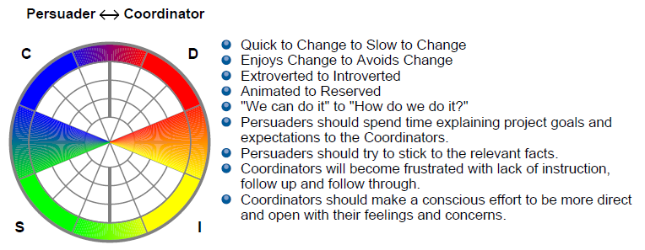
Behavioral Blending Challenges
Potential
Behavioral
Roadblocks
Notes:
To illustrate an example of potential behavioral blending challenges that a team can experience, let’s examine the potential behavioral roadblocks between two the eight general behavioral categories identified on the outside of the wheel. Our focus is going to be on the persuaders (reddish-orange pie piece) and coordinators (bluish-green pie piece). A comparison of the characteristics between these two styles indicate that we have introverts who respond slowly to change (coordinator) and extroverted people who respond to change more quickly and favorably. When given a challenge, the persuaders are going to focus on the outcome and indicate we can do it. Whereas the coordinators are going to focus on the process and be concerned about how it is going to be done. Having contrasting behavioral styles in the same group will make it harder to get consensus, especially when behavioral styles are almost opposite. Hopefully you can see from this example that being informed and aware of these differences will provide an opportunity for people with these contrasting styles to negotiate and navigate their dispositional differences related to behavioral style. Recognizing what we are not and what someone else is does not represent a weakness in the other person, but a difference that may be essential to the success of a team. Differences are neither good nor bad; they are just different and can strengthen a team.

Slide 32
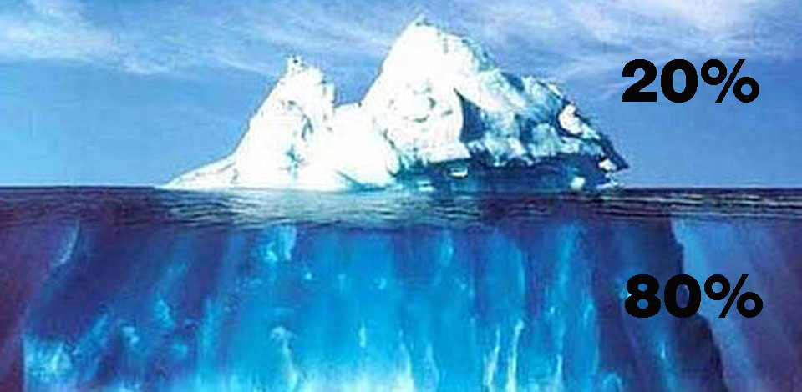
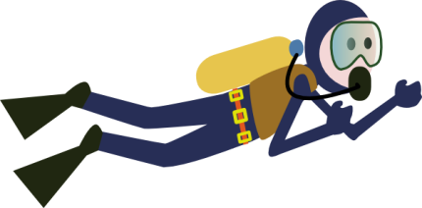
Reminder
Knowledge of an individual's motivators help to tell us WHY they do things. Energy and time.
Motivational Drivers – initiate behavior and are sometimes called the hidden motivators because they are not always readily observed.
DISC
10%
Motivational
Drivers
90%
Notes:
The DISC model interprets how we relate and interact with each other. We can choose to modify our behaviors. In contrast to our behaviors that are quite visible, the drivers for what we do are often hidden, and not readily observable or easily articulated. These are the “whys” behind what we do. They include our personal values and our passions. Our motivators are the values and beliefs we have developed over time. They are integral parts of us; some we may be born with and others are the result of our interactions with the outside world. The choices that we make to invest time, energy, resources, and money are indicators of our hidden motivations. As Simon Sinek highlights in his book Start with Why: How Great Leaders Inspire Everyone to Take Action, our choices and decisions are made in the limbic brain which is powerful, and where the “why” for the “what” and “how” of our actions lie. Motivators are like an engine beneath the hood of a car. It isn’t really seen by the outside world, but it is what powers us and fuels our behaviors. We need to know our “whys” and those of others.

Slide 33
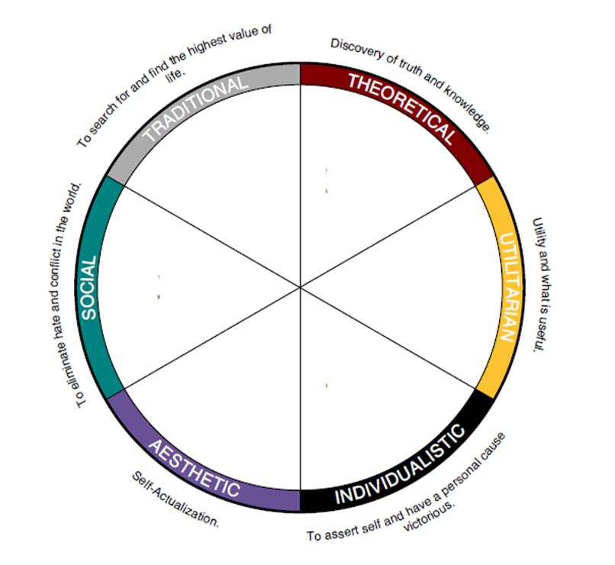
Why We Act The Way We Do
Motivational Drivers
Code to
live by
Learning
Help
Others
ROI
Destiny/
In-Charge
Harmony
Notes:
One tool that we have used to help characterize hidden motivators is the assessment developed by Target Training International based on the model of Spranger (1928). This model represents our motivational drivers using six domains.
• Theoretical – People who have this driver want to learn (click). They have a passion for learning. They love to study, read, take classes, and conduct research. When they get involved with something new, they want to learn as much as they can. They want knowledge for knowledge’s sake. They will appear to be intellectual and have a tendency to be cognitive, empirical, critical, and rational.
• Utilitarian – Individuals who have this driver have a desire to get a positive return on investment (ROI, click), which may be in the form of time, energy or financial. They have a characteristic interest in what is useful and practical, including money and accumulation of wealth. They will focus on practical results. They may seek money for the security of their present and future family, not necessarily just for themselves.
• Individualistic – Individuals who have this driver have a desire to be in control of their own destiny and that of others as well as a desire to be in charge. This may emerge as the need for power, control, and recognition. They like to lead and advance their position.
• Aesthetic – People who have this driver have a strong desire to create harmonious outcomes. They may perceive life as a procession of events, each that needs to be enjoyed for its own sake. Life is about experience and they have a tendency to be sensitive about conflict. They have an inherent interest in form, beauty, and harmony in the work. They will enjoy various forms and functions of art. Long range planning is a strength because they have a desire to create harmonious outcomes.
• Social – People who have this driver, which is also referred to as the social worker or altruistic motivator, value people and is kind, sympathetic, and unselfish. Helping others is high on their list of things to do. They are selfless and have a desire to give back to the community, charities, solve global social problems etc. They are typically generous with their time, talents, and resources.
• Traditional – Individuals who have this as a strong driver have a desire to live by a certain set of standards and/or beliefs upon which they base decisions. They adhere to defined rules, regulations, and principles for living. Commonly, they have very strong faith and/or cultural values. Their traditional values may stem from a variety of sources based on family and culture. They may or may not embrace a religion.

Slide 34
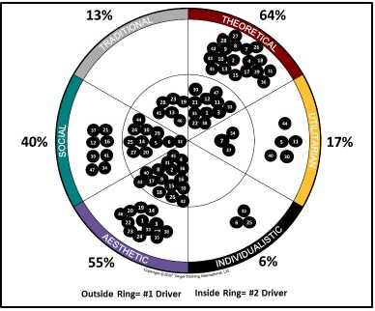
Why We Act The Way We Do
Motivational Drivers
Notes:
The top two motivators are usually the two most important drivers. This diagram illustrate the primary and secondary drivers for are group of environmental studies undergraduate students where the primary driver is in the outside ring and the secondary driver inside ring. For the class as whole, 64% of the students have the theoretical motivator as one of their top two drivers. Fifty-five percent of the students have the aesthetic driver as one of their top two. The social driver is in the top two for 40 percent of the students.

Slide 35
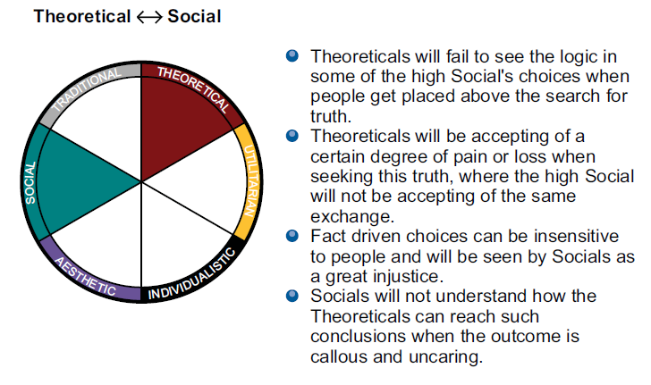
Motivational Blending Challenges
Potential
Motivational
Roadblocks
Notes:
To illustrate an example of potential motivational blending challenges that a team can experience, let’s examine the potential motivational roadblocks that may exist between two individuals selected from the group of students from the last slide, one who has theoretical as their primary driver and another who has social as their primary driver.
An examination of the potential challenges in the bulleted list indicates that a person who has a primary driver of theoretical is going to be driven to act by a different set of factors than a person driven by the social driver. Theoreticals will be driven by logic and data and will likely be less concerned about the extent to which is may impact people. They will seem to be uncaring and insensitive. The socials will be much more focused on the human-impact component of a decision and not see data and information as important.
This example does not take into the complexities of taking into consideration the secondary driver or all the variations that could influence choices by the individuals with other combinations of drivers. It does illustrate the potential for relationship roadblocks to develop between individuals on a team unless these dispositional attributes are addressed in some meaningful way.

Slide 36
Benefits of Assessments Summary
Instructors/Leaders/Coaches better understand how information may best be delivered.
Insights into the motivations behind people choices
Framework to open lines of communication (Boundary Object)
Unique learning experience that helps them better understand their behaviors and motivators and those of others
Tool to communicate their strengths, ideal work environment, and unique personal skill sets
Teams are more productive because students more clearly see roles, strengths and potential areas of weakness
Student understand their own strengths and personal attributes
Notes:
Every person on your team will have different behavioral characteristics and motivational drivers. Assessments provide an opportunity to develop a more complete picture of the individuals and the group that will help minimize the impact of potential behavioral and motivational roadblocks.

Slide 37
Reflect: Revisit your story
about a Good, Bad or Ugly Team/Group Experience
Assess your experience in the context to which differences in behavioral characteristics and motivational drivers amongst team members influenced the extent to which your experience was good, bad, or ugly.
Share assessment with your group – similarities and differences
Notes:
Revisit your story - Assess your experience in the context to which differences in knowledge, skill, expertise and mental models influenced the extent to which your experience was good, bad, or ugly.
Share your experiences with your group, compile experiences…similarities and differences.
Note common experiences for the class…..

Slide 38


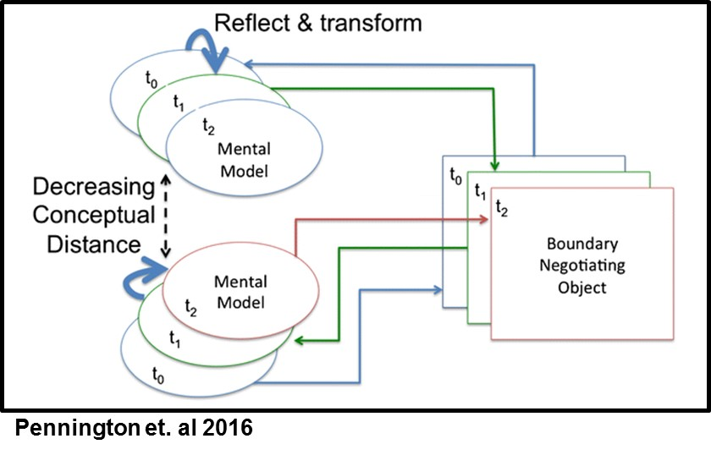
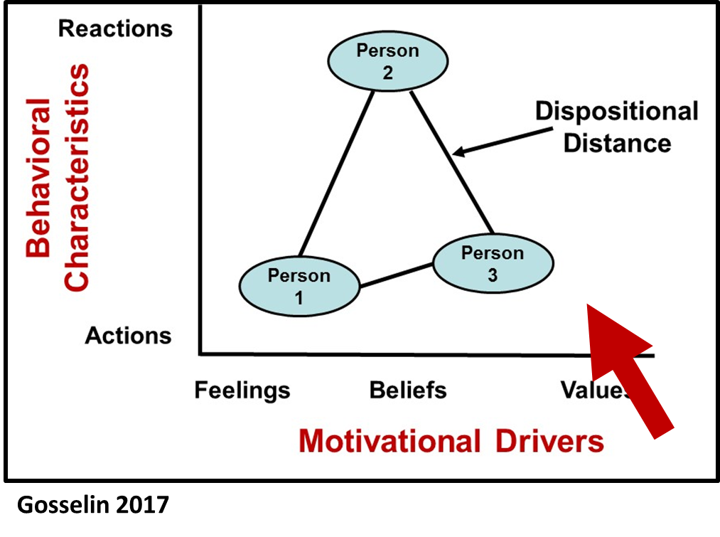
Our Challenge
Conceptual Distance
Dispositional Distance©
Create Silo Busters
Notes:
In our efforts to address the challenge of creating silo busters, it is important that teams use processes such as EMBeRS to decrease conceptual distance between team members. Every person on your team will have different behavioral characteristics and motivational drivers as schematically shown here. In either case, each person on a team needs to learn about these differences and how to navigate and negotiate the dispositional distances between group members so the team can get the most out of its talents and abilities.

Slide 39
Take
Away
Messages
Gosselin 2015
https://wmsbf.org/2013/02/21/1218/
Notes:
The key take away messages from this EMBERS activity are:
Click 1. We need to develop silo busters who can build collaborative to teams to Click 2. address wicked problems.
3. Regardless of your leadership paradigm or philosophy or model for your experience on collaborative teams, it is important that you have a model for how collaboration and interdisciplinary work should be done and be sure that your model uses Click 4 knowledge of who you are and whom you are leading successfully address wicked problems.

Slide 40




Questions
www.davegosselinphd.com

Slide 41
Post - Session Reflection
(Five-Minute Writing)
Writing Prompts
From your perspective, to what extent should the dispositional characteristics (behaviors, values, and motivational drivers) of team members be considered when forming and/or working on a collaborative team?
From your perspective, what are the key factors/characteristics that are important in the development of a collaborative team environment? Why are each important?

